Slide 1


Slide 2
Introduction

Slide 3
What is database?
Database is a systematic
collection of data.
Databases support storage
and manipulation of data.
Databases make data
management easy.
Applications: business, sales,
universities etc.,

Slide 4
Need of database?
Databases organize data items and maintain relationships
between them in order to facilitate effective information
sharing across an organization, the WWW, etc.
To manage large chunks of data
Accuracy
Ease of updating data
Data integrity
Security of data

Slide 5
Data modelling
Data model is an abstract model
that defines how data is stored
and related to another.
File system
A database file system is a file
system interface placed on top
of files and directories that are
stored in database tables.

Slide 6
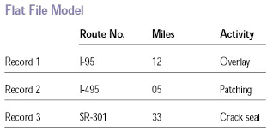
Flat file model:
A flat file model is a database stored as an ordinary
unstructured file called “flat file”
Flat file databases are generally in plain-text form, where
each line holds only one record

Slide 7
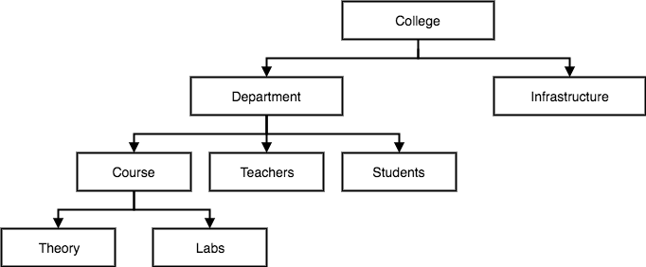
Hierarchical database
It is a data model in which the data is organized into a tree like
structure.
The entity type records defines which fields the record item
contain

Slide 8
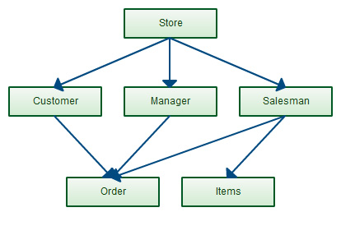
Network data model
An enhanced form of hierarchical model is data model, the
network model represents data in a tree of records.
Relationship between tables(records) are expressed as sets.
Related records in a set are directly linked by pointers, rather than
maching duplicates as in case of Relational Data Model.

Slide 9
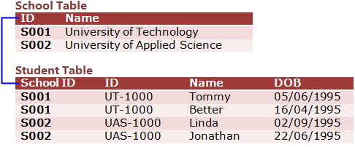
Relational data model
Data is organised in two dimensional tables called “Relations”.
A relational data model involves the use of data tables that collect groups of
elements into relations.
Consists of three Major components:
set of relations
Integrity rules
Operations performed

Slide 10
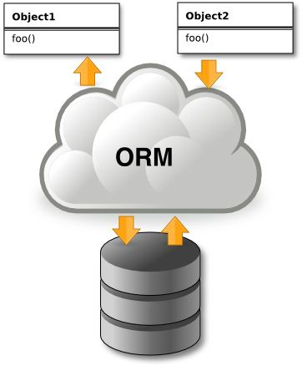
Object relational model
An ORDBMS has a relational model in
it, because the data is stored in the
form of tables having rows and
columns.
SQL is used as the query language,
and the result of the query is also
table or tuple (rows).

Slide 11
File based approach
File based Approach is a traditional approach of collecting
and storing data.
In this approach data is stored in files.
Each unit of organization has its own files and each file has a specific
set of programs that were used to manipulate data in that file.
Each department collected and maintained the required data.
DISADVANTAGE:
This usually resulted in duplication of data and inconsistency of
data.

Slide 12
DISADVANTAGE:
This usually resulted in duplication of
data and inconsistency of data.
Separation and isolation of data.
Fixed assistance of queries.
Incompatibity of files

Slide 13
DBMS

Slide 14
DATA BASE APPROACH
The Database is a shared collection of logically related data, designed to
meet the information needs of an organization.
A database is a computer based record keeping system whose over all
purpose is to record and maintains information.
The database is a single, large repository of data, which can be used
simultaneously by many departments and users.
Instead of disconnected files with redundant data, all data items are
integrated with a minimum amount of duplication.

Slide 15
GUIDELINES(REFER ONLY)
Data file is a collection of related records stored on storage medium such as hard disk or optical disk while Database is a collection of data organized in a manner that allows access , retrieval and use of that data.

Slide 16


Slide 17
Database
An organized collection of data, stored and accessed electronically.
Database Management System
System software for creating and managing databases.
Provides users and programmers with a systematic way to create, retrieve, update and
manage data.

Slide 18

Why DBMS?
Data independency, integrity & security.
Data is very structured.
Persistent and valuable data.
Concurrent access to data.
Backup and recovery services.

Slide 19
DBMS
Can offer both logical and physical data independence
Manages three important things
The Physical database
The database engine
The database scheme

Slide 20





Functions of DBMS
Data Transmission

Slide 21
Terminologies

Slide 22
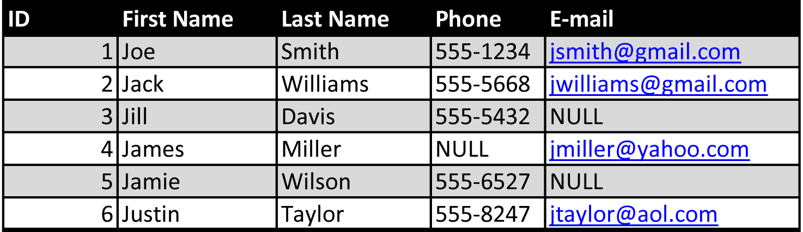
Entity
Attribute
Domain
Tuple
Degree
Cardinality

Slide 23
Advantages of DBMS
Controlling data redundancy
Data sharing & Data consistency
Integration constraints
Control over concurrency
Data Independence

Slide 24
RDBMS

Slide 25
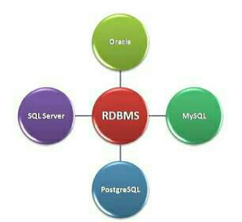
RDBMS
Stands for Relational Data Base Management System.
Data is stored in the form of tables and there is relationship between these tables.

Slide 26
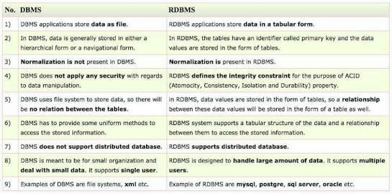
Difference between DBMS and RDBMS

Slide 27
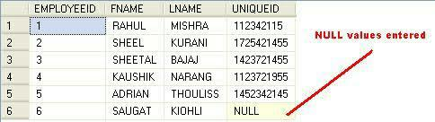
RDBMS Terminologies
Relation – It is a table organized in rows and columns.
Tuple – It is a row of a relation and represents an instance of a relation.
Field – A field is a column in a table that is designed to maintain specific information about every record in a table.
Null – It signifies “no value”.

Slide 28
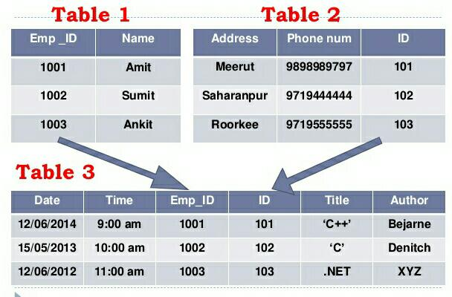
Relationship
Relationship defines how two tables are linked to each other.

Slide 29
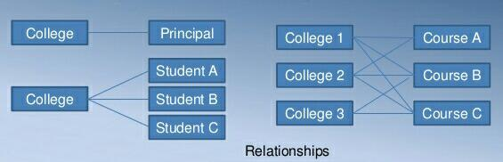
Relationship Types
There are 3 types of relationship :
One-to-one
One-to-many
Many-to-many

Slide 30
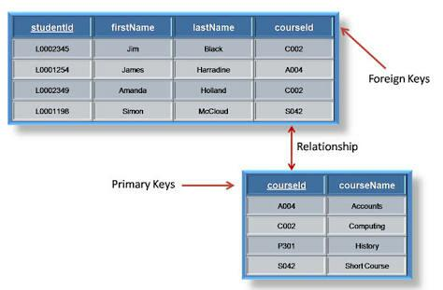
Keys in RDBMS
Primary key - It is a column or group of columns in a table that uniquely
identifies rows in that table.
Foreign key – It is a field in a table that is primary key in another table. It is
used to link two tables.

Slide 31
Constraints
Constraints enforce limits to the data or the type of data that can
be inserted/updated/deleted from a table.
The purpose of constraints is to maintain the data integrity.
Commonly used constraints available in SQL :
NOTNULL Constraints
Unique Constraints
Primary key
Foreign key

Slide 32
EF Codd Rules
Dr. EF Codd proposed thirteen rules and said if DBMS meets these rules, it can be
called as RDBMS.
Rule 0 – Foundation rule
Rule 1 – The information rule
Rule 2 – The guaranteed access rule
Rule 3 – Systematic treatment of null values
Rule 4 – Active online catalog based on relational model
Rule 5 – The comprehensive data sub language rule
Rule 6 – The view updating rule
Rule 7 – High level insert, update and delete
Rule 8 – Physical data independence
Rule 9 – Logical data independence
Rule 10 – Integrity independence
Rule 11 – Distribution independence
Rule 12 – The non subversion rule

Slide 33
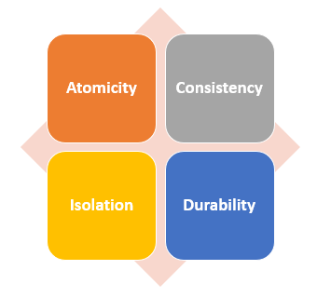
ACID Properties
A set of properties of database transactions intended to guarantee validity
even in the event of errors, power failures, etc.
Coined by Andreas Reuter and Theo Harder in 1983.

Slide 34
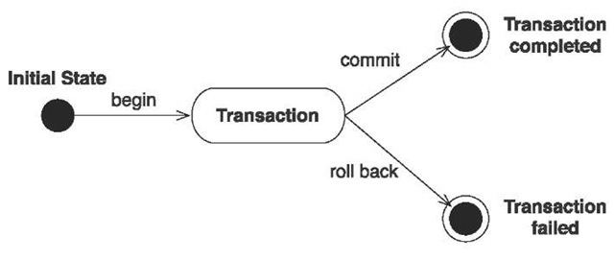
ATOMICITY
Principle of all-or-nothing occurs.
It states a transaction that is either performed as a whole or not performed
at all.

Slide 35
CONSISTENCY
Ensures that a transaction can only bring the database from one valid state to another.
This prevents database corruption by an illegal transaction, but does not guarantee that
a transaction is correct.
ISOLATION
Ensures that concurrent execution of transactions leaves the database in the same state
if the transactions were executed sequentially.
Level of Isolation
Level 0
Level 1
Level 2
Level 3.

Slide 36
DURABILITY
Guarantees that once a transaction has been committed, it will remain
committed even in the case of a system failure.
Use of database backups and transaction logs that facilitate the restoration
of committed transactions in spite of any subsequent software or hardware
failures.
Transaction stays persistent.

Slide 37
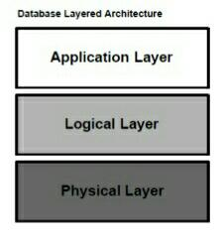
Database Layered Architecture
All database systems, can be viewed as a three layered architecture at the
highest level of abstraction. It has three main components :

Slide 38
Application Layer : It represents the interface for all users of the system; it
essentially provides the means by which outside World can communicate with
database server.
Logical Layer : It is more detailed structure that defines what has to be done to
support the user services. It defines the processes that perform functions and the
information or data flows that are shared between these processes.
Physical Layer : Mainly deals with the storage of variety of information, which is
kept in secondary storage and accessed via the storage manager.

Slide 39
Normalization

Slide 40
Normalization
Database Normalization is a technique of organizing the data in the database.
Normalization is a systematic approach of decomposing tables to eliminate data redundancy and undesirable characteristics like Insertion, Update and Deletion anomalies. It is a multi-step process that puts data into tabular form by removing duplicated data from the relation tables.
Normalization is used for mainly two purpose,
Eliminating redundant (useless) data.
Ensuring data dependencies make sense i.e data is logically stored.

Slide 41
Problems without normalization
Without Normalization, it becomes difficult to handle and update the database, without facing data loss. Insertion, Updation and Deletion anamolies are very frequent if Database is not Normalized. Lets look at Student table.
sid | Student name | location | Subject
101 | Ravi | Hyderabad | maths
102 | Subbu | Bangalore | economics
103 | Archana | Chennai | maths
101 | Ravi | Hyderabad | physics

Slide 42
Problems without normalization
Updation Anamoly: To update address of a student who occurs twice or more than twice in a table, we will have to update S_Address column in all the rows, else data will become inconsistent.
Insertion Anamoly: Suppose for a new admission, we have a Student id (S_id), name and address of a student but if student has not opted for any subjects yet then we have to insert NULL there, leading to Insertion Anamoly.
Deletion Anamoly: If (S_id) 102 has only one subject and temporarily he drops it, when we delete that row, entire student record will be deleted along with it.

Slide 43
Dependencies
Multivalued Attributes (or repeating groups): non-key attributes or groups of non-key attributes the values of which are not uniquely identified by (directly or indirectly) (not functionally dependent on) the value of the Primary Key (or its part).

Slide 44
Partial Dependency – when an non-key attribute is determined by a part, but not the whole, of a COMPOSITE primary key.
Transitive Dependency – when a non-key attribute determines another non-key attribute.

Slide 45
First Normal form (1NF)
A Relation is in 1NF ,if it contains no repeating Groups and all values in attributes are atomic and key attribute are identified
Example
Bringing a Relation to 1NF
Option 1: Make a determinant of the repeating group (or the multivalued attribute) a part of the primary key.
Composite Primary Key

Slide 46
Bringing a Relation to 1NF

Slide 47
Second Normal Form
A Relation is said to be 2NF ,if it is in 1NF and no partial Dependency
Example
Partial Dependencies
Composite Primary Key

Slide 48
Second Normal Form

Slide 49
Third Normal Form
A relation said to be 3NF ,if it in 2NF and no transistion dependency
Example

Slide 51
BCNF
When a relation has more than one candidate key, anomalies may result even though the relation is in 3NF.
3NF does not deal satisfactorily with the case of a relation with
overlapping candidate keys
i.e. composite candidate keys with at least one attribute in common.
BCNF is based on the concept of a determinant.
A determinant is any attribute (simple or composite) on which some
other attribute is fully functionally dependent.
A relation is in BCNF is, and only if, every determinant is a candidate key.

Slide 52
SQL

Slide 53

SQL
Structure Query Language.
It is used for storing and managing data in RDBMS. It enables a user to create, read, update and delete relational databases and tables.
SQL allows users to query the database in a numbers of ways, using English-like statements.

Slide 54
SQL Datatypes
SQL Datatypes
Binary
Approximate Numeric
Exact Numeric
Date
String

Slide 55
Binary Datatypes
DATA TYPE | DESCRIPTION
BINARY | Maximum length of 8000 bytes Fixed-length binary data
VARBINARY | Maximum length of 8000 bytes Variable-length binary data
IMAGE | Maximum length of 2,147,483,647 bytes Variable-length binary data

Slide 56
Approximate Numeric Datatypes
DATA TYPE | FROM | TO
FLOAT | -1.79E + 308 | 1.79E + 308
REAL | -3.40e + 38 | -3.40e + 38

Slide 57
Exact Numeric Datatypes
DATA TYPE | FROM | TO | STORAGE
bit | 0 | 1
tinyint | 0 | 255 | 1 byte
smallint | -32,768 | 32,768 | 2 bytes
int | -2,147,483,648 | 2,147,483,648 | 4 bytes
bigint | -9,223,372,036,854,775,808 | 9,223,372,036,854,775,808 | 8 bytes
decimal (p,s) | -10³⁸ + 1 | 10³⁸ - 1 | 5-17 bytes
numeric (p,s) | -10³⁸ + 1 | 10³⁸ - 1 | 5-17 bytes
smallmoney | -214,748.3648 | 214,748.3648 | 4 bytes
money | -922,337,203,685,477.5808 | 922,337,203,685,477.5808 | 8 bytes
**p – 1 to 38 : Default 18 ; s – 0 to p : Default 0

Slide 58
String Datatypes
DATA TYPE | DESCRIPTION | MAX SIZE
char | Fixed width character string | 8,000 characters
varchar | Variable width character string | 8,000 characters
varchar(max) | Variable width character string | 1,073,741,824 characters
text | Variable width character string | 2GB of text data
nchar | Fixed width Unicode string | 4,000 characters
nvarchar | Variable width Unicode string | 4,000 characters
nvarchar(max) | Variable width Unicode string | 536,870,912 characters
ntext | Variable width Unicode string | 2GB of text data

Slide 59
Date Datatypes
DATA TYPE | DESCRIPTION | STORAGE
datetime | From January 1, 1753 to December 31, 9999 with an accuracy of 3.33 milliseconds | 8 bytes
datetime2 | From January 1, 0001 to December 31, 9999 with an accuracy of 100 nanoseconds | 6-8 bytes
smalldatetime | From January 1, 1900 to June 6, 2079 with an accuracy of 1 minute | 4 bytes
date | Store a date only. From January 1, 0001 to December 31, 9999 | 3 bytes
time | Store a time only to an accuracy of 100 nanoseconds | 3-5 bytes
timestamp | Stores a unique number that gets updated every time a row gets created or modified. The timestamp value is based upon an internal clock and does not correspond to real time. Each table may have only one timestamp variable

Slide 60
SQL Commands
DDL
Create
Drop
DML
Insert
Update
DCL
Grant
Revoke
TCL
DQL
Alter
Truncate
Delete
Commit
Rollback
Savepoint
Select

Slide 61
DDL – Data Definition Language
DDL changes the structure of the table like: creating a table, deleting a
table, altering a table, etc.
DDL commands are auto-committed that means it permanently save all the
changes in the database.
CREATE
DROP
ALTER
TRUNCATE

Slide 62
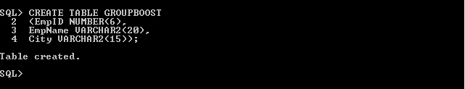
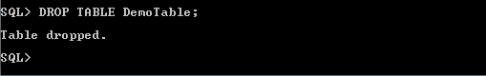
1. CREATE
It is used to create new table in the database.
2. DROP
Deletes both the structure and record stored in the table.

Slide 63
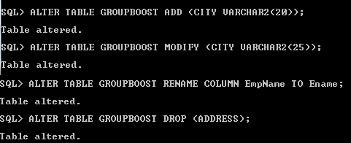
3. ALTER
Used to alter the structure of the database : ADD, MODIFY, RENAME, DROP.
4. TRUNCATE
Deletes all the rows from the table and free the space containing the table.

Slide 64
DML – Data Manipulation Language
DML commands are used to modify the database. It is responsible for all
form of changes in the database.
The command of DML are not auto-committed. They can be rollback.
INSERT
UPDATE
DELETE

Slide 65
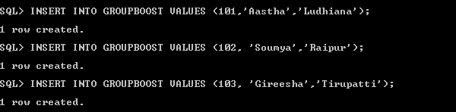
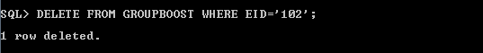
1. INSERT
It is used to create new table in the database.
2. DELETE
It is used to remove one or more row from a table.

Slide 66
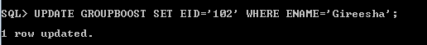
3. UPDATE
This command is used to update or modify the value of column in the table.

Slide 67
DQL – Data Query Language
DQL is used to fetch the data from the database.
SELECT

Slide 68
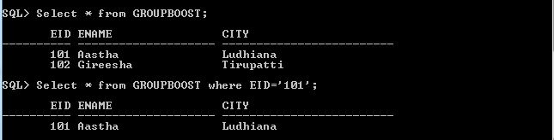
Select :
It is used to select the attribute based on the condition described by
WHERE clause.

Slide 69
DCL – Data Control Language
DCL commands are used to grant and take back authority from any database user.
GRANT : Used to provide any user access privileges or other priviliges for the
database.
REVOKE : Used to take back permissions from any user.
GRANT
REVOKE

Slide 70
Allow a User to create table
Grant all privilege to a User
Grant permission to create any table
Grant permission to drop any table
To take back Permissions

Slide 71
TCL – Transaction Control Language
TCL commands are used to manage transactions in the database. These are used
to manage the changes made to the data in a table by DML statements.
It also allows statements to be grouped together into logical transactions.
COMMIT
ROLLBACK
SAVEPOINT

Slide 72
COMMIT - used to permanently save any transaction into the database.
ROLLBACK - restores the database to last commited state. It is also used with savepoint command to jump to a savepoint in an ongoing transaction.
SAVEPOINT - used to temporarily save a transaction so that you can rollback to that point whenever required.

Slide 73
SQL Joins
SQL Join is used to fetch data from two or more tables, which is joined to appear
as single set of data. It is used for combining column from two or more tables by
using values common to both tables.
TYPES :
Inner Join
Left Outer Join
Right Outer Join
Full Outer Join

Slide 74
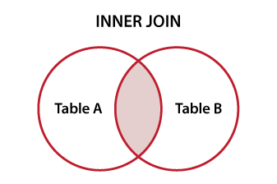
Inner JOIN
Select all records from Table A and Table B, where the join condition is met.
Select table1.column1,table1.column2,table2.column1,....
FROM table1
INNER JOIN table2
ON table1.matching_column = table2.matching_column;

Slide 75
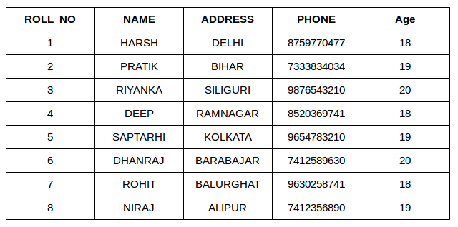
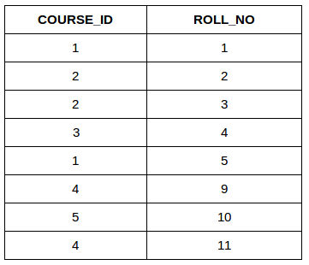
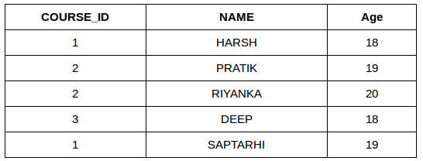
SELECT StudentCourse.COURSE_ID, Student.NAME, Student.AGE FROM Student
INNER JOIN StudentCourse
ON Student.ROLL_NO = StudentCourse.ROLL_NO;

Slide 76
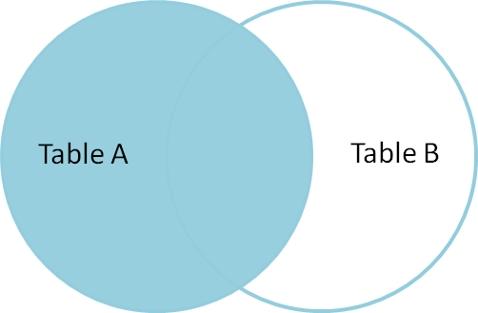
2. Left Outer JOIN
This join returns all the rows of the table on the left side of the join and matching rows
for the table on the right side of join.
The rows for which there is no matching row on right side, the result-set will contain null.
Select table1.column1,table1.column2,table2.column1,....
FROM table1
LEFT JOIN table2
ON table1.matching_column = table2.matching_column;

Slide 77
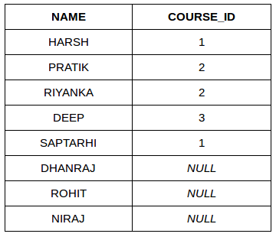
SELECT StudentCourse.COURSE_ID, Student.NAME, Student.AGE FROM Student
LEFT JOIN StudentCourse
ON Student.ROLL_NO = StudentCourse.ROLL_NO;

Slide 78
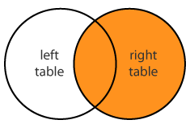
3. Right Outer JOIN
This join returns all the rows of the table on the right side of the join and matching
rows for the table on the left side of join.
The rows for which there is no matching row on left side, the result-set will
contain null.
Select table1.column1,table1.column2,table2.column1,....
FROM table1
RIGHT JOIN table2
ON table1.matching_column = table2.matching_column;

Slide 79
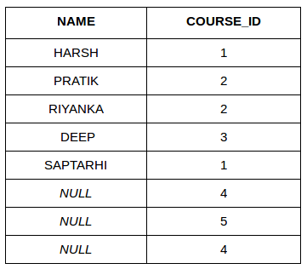
SELECT StudentCourse.COURSE_ID, Student.NAME, Student.AGE FROM Student
RIGHT JOIN StudentCourse
ON Student.ROLL_NO = StudentCourse.ROLL_NO;

Slide 80
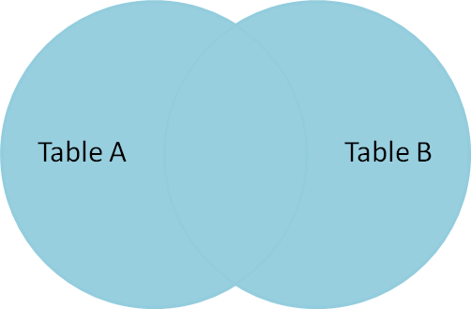
4. Full Outer JOIN
FULL JOIN creates the result-set by combining result of both LEFT JOIN and RIGHT JOIN
The result-set will contain all the rows from both the tables. The rows for which there is no matching, the result-set will contain NULL values.
Select table1.column1,table1.column2,table2.column1,....
FROM table1
FULL JOIN table2
ON table1.matching_column = table2.matching_column;

Slide 81
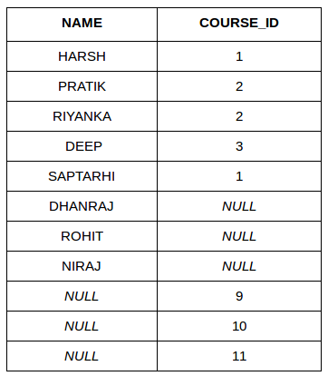
SELECT StudentCourse.COURSE_ID, Student.NAME, Student.AGE FROM Student
FULL JOIN StudentCourse
ON Student.ROLL_NO = StudentCourse.ROLL_NO;

Slide 82
Different RDBMS
Products

Slide 83
FEATURE
DESCRIPTION
OS
INTERFERENCE
LICENCE
LANGUAGES
My SQL | Oracle | Ingres | MS SQL
RDBMS | RDBMS | RDBMS | DBMS
Windows, linux solaris etc; | Windows, Linux, free BSD etc; | Windows, Linux etc., | Windows
GUI ,SQL | SQL | GUI,SQL | GUI,SQL,VARIOUS
OPEN SOURCE | COMMERCIAL | OPEN SOURCE | COMMERCIAL
Ada C C# C++ D Java Perl PHP Python RubyTcl etc., | C C# Perl PHP Python Visual Basic etc; | .Net C C++ Delphi Java Perl PHP Python Tcl | JAVA, RUBY, PHYTHON,.NET,VB and PHP

Slide 84
T
THANK YOU

